Slide 1
This slide is hidden.
Insert the starting slides after this slide

Slide 2
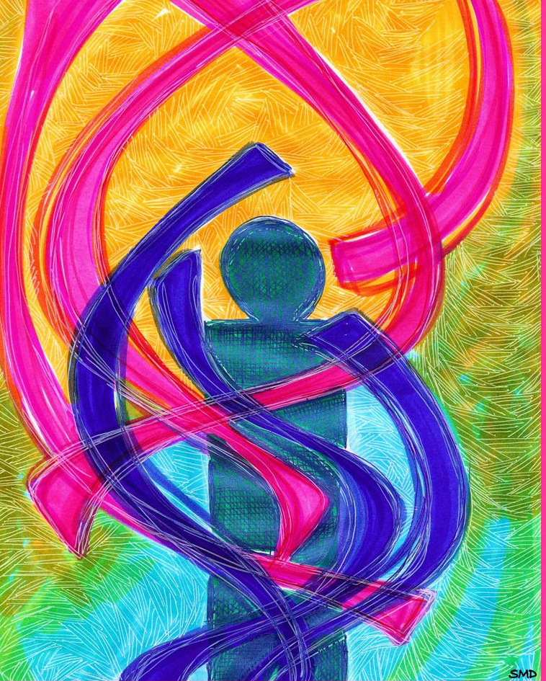
Welcome to St Michael’s
2nd Sunday Ordinary Time Year A
You have entered a
SACRED SPACE
– a SACRED TIME...
Please ensure all mobile phones
are switched off.
Please be respectfully quiet
as we prepare for our celebration.
Notes:
Saturday 5.30PM First Sunday of Advent
2nd Sunday Ordinary Time Year A 19th Juanuary 2014

Slide 3
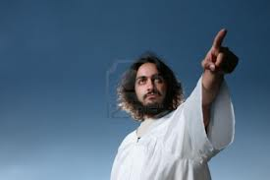
Seeing Jesus coming towards him, John said, 'Look, there is the Lamb of God …

Slide 4
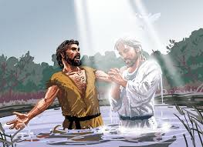
John also declared, “I saw the Spirit coming down on him from heaven like a dove and resting on him.”

Slide 5
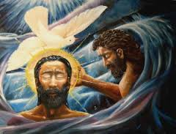
I am the witness that he is the Chosen One of God.'

Slide 6
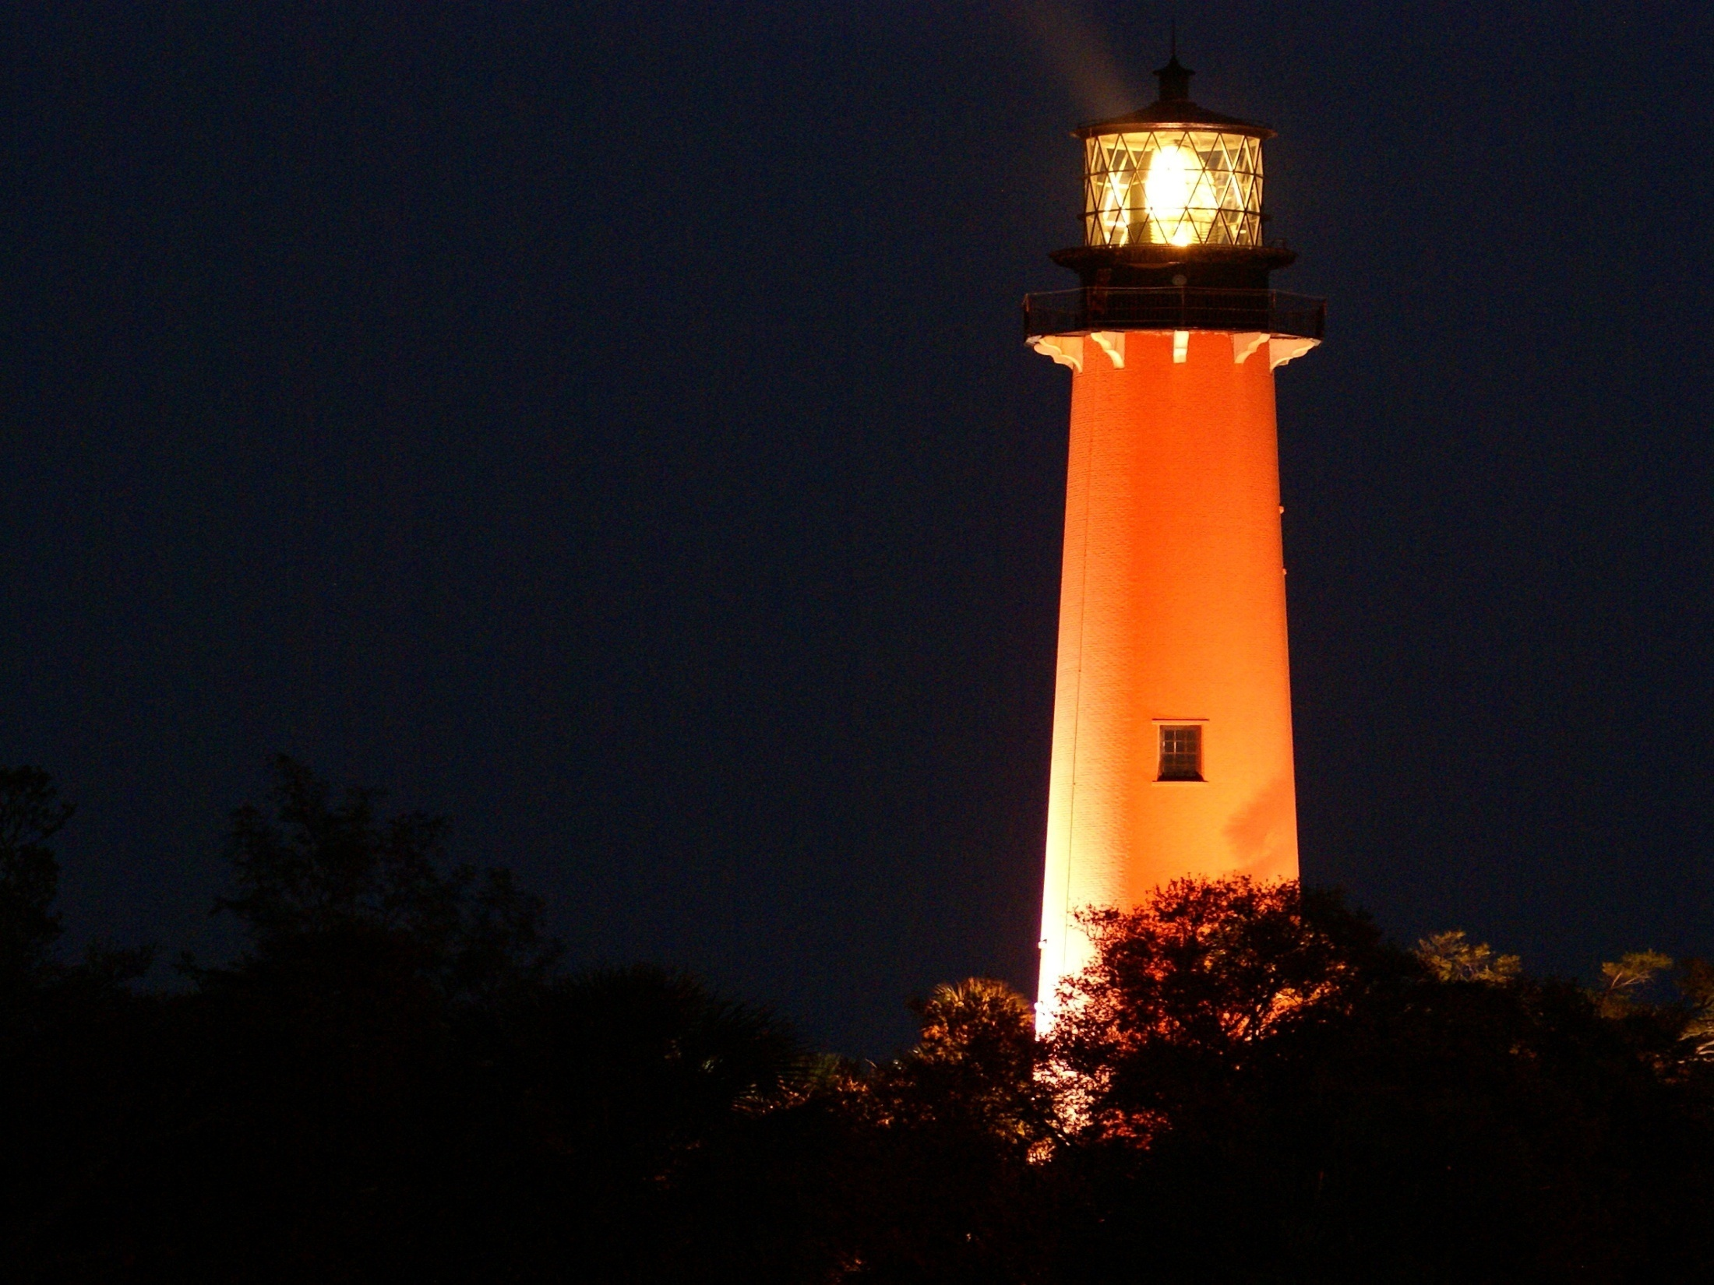
Who in your life reminds you of John the Baptist, because his or her words and actions lead you toward Jesus?

Slide 7
Please Stand

Slide 8
Gather as One
Amanda McKenna
Gather as one, Gather as one.
Gather all the people of God!
All of our days singing God's praise
Gather all the people as one

Slide 9
Gather as one, Gather as one.
Gather all the people of God!
All of our days singing God's praise
Gather all the people as one

Slide 10
We will sing a new song unto the Lord,
Of truth and beauty surrounding our God;
Of holiness and glory
Sing out to the Lord, all the earth!

Slide 11
Gather as one, Gather as one.
Gather all the people of God!
All of our days singing God's praise
Gather all the people as one

Slide 12
Gather all the nations unto the Lord.
Bring us together, our Lord and our God
And we will come rejoicing,
Proclaiming the Lord's holy name!

Slide 13
Gather as one, Gather as one.
Gather all the people of God!
All of our days singing God's praise
Gather all the people as one
Gather all the people as one

Slide 14
This slide is hidden.
Insert the Entrance Hymn after this slide

Slide 16
Confiteor
I confess to almighty God
And to you, my brothers and sisters,
That I have greatly sinned
In my thoughts and in my words

Slide 17
In what I have done
And in what I have failed to do,
Through my fault,
Through my fault,
Through my most grievous fault;

Slide 18
Therefore I ask blessed Mary ever-Virgin,
All the Angels and Saints,
And you, my brothers and sisters,
To pray for me to the Lord our God.

Slide 20
Kyrie eleison
Kyrie eleison (2)
Christe eleison (2)
Kyrie eleison (2)

Slide 22
Glory to God
Glory to God in the highest,
And on earth peace to people of good will.
We praise you, we bless you,
We adore you, we glorify you

Slide 23
We give you thanks for your great glory,
Lord God heavenly King,
O God, almighty Father

Slide 24
Lord Jesus Christ, only begotten Son,
Lord God, Lamb of God,
Son of the Father,

Slide 25
You take away the sins of the world,
Have mercy on us;
You take away the sins of the world,
Receive our prayer;

Slide 26
You are seated
At the right hand of the Father
Have mercy on us

Slide 27
For you alone are the Holy One,
You alone are the Lord
You alone are the most High,
Jesus Christ

Slide 28
With the Holy Spirit,
In the glory of God the Father.
Amen!
Amen!

Slide 29
Gloria
Glory to God in the highest,
and on earth peace to people of good will.
We praise you, we bless you,
we adore you, we glorify you,

Slide 30
We give you thanks for your great glory,
Lord, God heavenly king,
O God, almighty father

Slide 31
Glory to God in the highest,
and on earth peace to people of good will.

Slide 32
Lord Jesus Christ, Only Begotten Son,
Lord God, Lamb of God, Son of the Father,
you take away the sins of the world,
have mercy on us;

Slide 33
you take away the sins of the world, receive our prayer;
you are seated at the right hand of the Father,
have mercy on us.

Slide 34
Glory to God in the highest,
and on earth peace to people of good will.

Slide 35
For you alone are the Holy One,
you alone are the Lord,
you alone are the Most High, Jesus Christ,
with the Holy Spirit,
in the glory of God the Father.

Slide 36
Glory to God in the highest,
and on earth peace to people of good will.
Amen.

Slide 38
Responsorial Psalm
Here I am, Lord;
I come to do your will.

Slide 40
Alleluia
Alleluia, alleluia,
alleluia, alleluia
Alleluia, alleluia,
Alleluia alleluia.

Slide 42
Apostles Creed
I believe in God,
the Father almighty,
Creator of heaven and earth,
and in Jesus Christ, his only Son, our Lord,
(At the words that follow, up to and including the Virgin Mary, all bow.)

Slide 43
who was conceived by the Holy Spirit,
born of the Virgin Mary,
suffered under Pontius Pilate,
was crucified, died and was buried;
he descended into hell;

Slide 44
on the third day he rose again from the dead;
he ascended into heaven,
and is seated at the right hand of God the Father almighty;

Slide 45
from there he will come to judge the living and the dead.
I believe in the Holy Spirit,
the holy catholic Church,

Slide 46
the communion of saints,
the forgiveness of sins,
the resurrection of the body,
and life everlasting.
Amen.

Slide 48
First Collection
This collection goes to the Bishop
for the support of the Diocese.
Thank you for your contribution

Slide 50
This slide is hidden.
Insert the Offertory Hymn after this slide.

Slide 52
All that we have
All that we have
and all that we offer,
Comes from a heart
Both frightened and free.

Slide 53
Take what we bring,
The work of our hands,
All done in his name.

Slide 54
Some would rely on their power,
Others put trust in their gold,
Some have only their saviour,
Whose faithfulness never grows old.

Slide 55
All that we have
and all that we offer,
Comes from a heart
Both frightened and free.

Slide 56
Take what we bring,
The work of our hands,
All done in his name.

Slide 57
Priest: Pray my brothers and sisters,
that my sacrifice and yours may be
acceptable to God, the almighty Father.
All: May the Lord accept the sacrifice
at your hands for the praise and glory of his name, for our good and the good of all his holy Church.

Slide 58
Priest: The Lord be with you.
All: And with your spirit.
Priest: Lift up your hearts.
All: We lift them up to the Lord.

Slide 59
Priest: Let us give thanks to the
Lord our God.
All: It is right and just.

Slide 61
Holy
Holy, Holy, Holy Lord God of hosts,
Heaven and earth are full of your glory. Hosanna in the highest
Blessed is he who comes
in the name of Lord,
Hosanna in the highest.

Slide 63
Memorial acclamation
Save us saviour of the world,
For by your cross and resurrection,
You have set us free

Slide 64
Memorial acclamation
When we eat this bread
And drink this cup
We proclaim your death O Lord
Until you come again

Slide 65
Memorial acclamation
We proclaim your death O Lord
And profess your resurrection
Until you come again

Slide 67
Amen
Amen, amen.
Amen, amen.

Slide 69
Priest: The Lord be with you.
All: And with your spirit

Slide 71
Peace
May the peace of the Lord be with you
With your friends and your family too
Let it be, let it grow
And everywhere you go
May the peace of the Lord follow you

Slide 72
Lamb of God
Lamb of God
You take away the sins of the world
Have mercy on us.

Slide 73
Lamb of God
You take away the sins of the world
Have mercy on us

Slide 74
Lamb of God
You take away the sins of the world
Grant us peace

Slide 76
Priest: Behold the Lamb of God, behold him who takes away the sins of the world.
Blessed are those called to the supper of
the Lamb.
All: Lord, I am not worthy
that you should enter under my roof,
but only say the word
and my soul shall be healed.

Slide 77
This slide is hidden.
Insert the Communion Hymns after this slide.

Slide 78
As the deer panteth
As the deer panteth for the water
So my soul longeth after thee
You alone are my heart’s desire
and I long to worship thee.

Slide 79
You alone are my strength my shield
To you alone may my spirit yield.
You alone are my heart’s desire
And I long to worship thee

Slide 80
I want you more than gold and silver
Only you can satisfy
You alone are the true joy giver
And the apple of my eye

Slide 81
You alone are my strength my shield
To you alone may my spirit yield.
You alone are my heart’s desire
And I long to worship thee

Slide 82
You are mine yes, you are my brother
Even though you are a King.
I love you more than any other
And much more than anything

Slide 83
You alone are my strength my shield
To you alone may my spirit yield.
You alone are my heart’s desire
And I long to worship thee

Slide 84
Give thanks
Give thanks with a grateful heart
Give thanks to the Holy One
Give thanks because He's given
Jesus Christ, His Son

Slide 85
Give thanks with a grateful heart
Give thanks to the Holy One
Give thanks because He's given
Jesus Christ, His Son

Slide 86
And now let the weak say, "I am strong"
Let the poor say, "I am rich
Because of what the Lord
has done for us"

Slide 87
And now let the weak say, "I am strong"
Let the poor say, "I am rich
Because of what the Lord
has done for us"

Slide 88
Give thanks with a grateful heart
Give thanks to the Holy One
Give thanks because He's given
Jesus Christ, His Son

Slide 89
Give thanks with a grateful heart
Give thanks to the Holy One
Give thanks because He's given
Jesus Christ, His Son

Slide 90
And now let the weak say, "I am strong"
Let the poor say, "I am rich
Because of what the Lord
has done for us"

Slide 91
And now let the weak say, "I am strong"
Let the poor say, "I am rich
Because of what the Lord
has done for us"
Give thanks

Slide 93
Second Collection
What you contribute now
is for the support of our
parish and its mission.
Thank you for your generosity

Slide 94
This slide is hidden.
Insert the Notices for the week after this slide

Slide 95
Office Hours for January
St Michael’s
9.00am – 12.00Noon (Monday - Thursday)
St Patrick’s
9.00am – 3.00pm (Monday – Friday)

Slide 96

BEGINNING THEOLOGY
Apply now!
www.instituteformission.com.au
Fr Paul Roberts 98314911

Slide 97

Liturgical Ministry Formation Courses for Feb - May 2014
Institute For Mission - IFM
1 - 5 Marion Street Blacktown
Monday Evenings 7.00pm - 9.00pm.

Slide 98

SACRAMENTAL PROCESS 2014
Are you children in Year 3 or above …. then please register them for Sacraments NOW!
Reconciliation (Confession/Penance)
Eucharist (Communion)
Confirmation
Forms available Church Foyers; Parish Offices or Parish Websites

Slide 99

Please take home your bulletin or download it
www.stmichaelsparish.com
www.facebook.com/blacktowncatholics

Slide 100
This slide is hidden.
The next slide can be used for videos.
Insert the video into the slide.

Slide 102
Priest: The Lord be with you.
All: And with your spirit.

Slide 104
This slide is hidden.
Insert the Recessional Hymns after this slide.

Slide 105
Shout to the Lord
My Jesus, my Saviour
Lord there is none like You,
All of my days, I want to praise
The wonders of Your mighty love.

Slide 106
My comfort, my shelter
Tower of refuge and strength,
Let every breath, all that I am
Never cease to worship You.

Slide 107
Shout to the Lord, all the earth let us sing
Power and majesty, Praise to the King.
Mountains bow down and the seas will roar
At the sound of Your name.

Slide 108
I sing for joy at the work of Your hands.
Forever I'll love You, forever I'll stand.
Nothing compares to the promise I have
Nothing compares to the promise I have
Nothing compares to the promise I have
In You

Slide 109
This slide is hidden.
Insert the final slide here.

